Slide 1
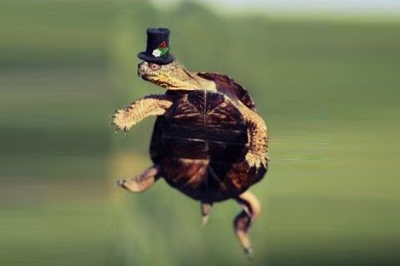

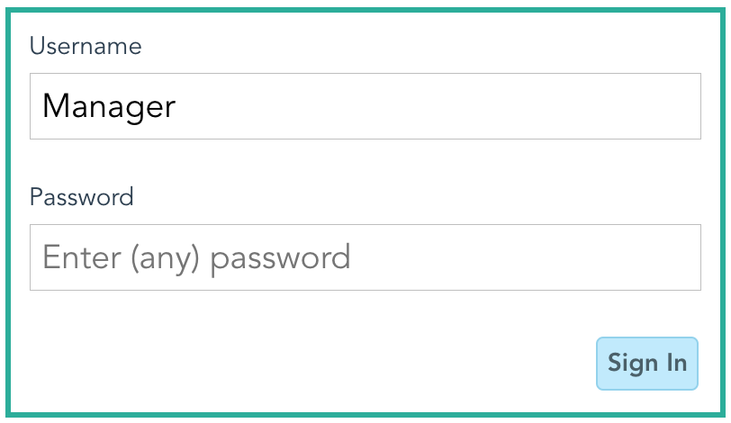
Dancing Turtles
Notes:
Talk about
pervious comp
Who we are
Why they hired us (what page does-managerial view)
And beta app

Slide 2
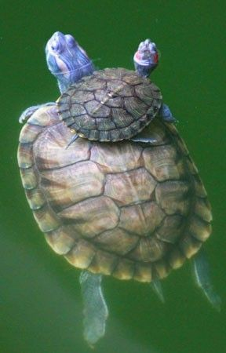
Parenting Turtles
Notes:
Talk about
pervious comp
Who we are
Why they hired us (what page does-managerial view)
And beta app

Slide 3
Tutoring Turtles
Team 6
Notes:
Talk about
pervious comp
Who we are (Chief engineer)
Why they hired us (what page does-managerial view)
And beta app

Slide 4
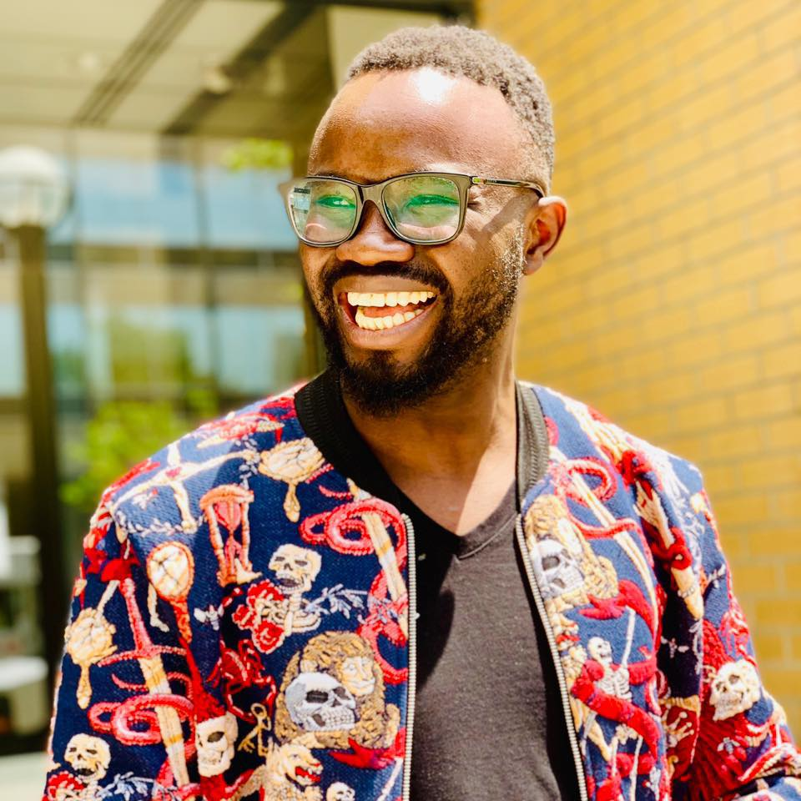
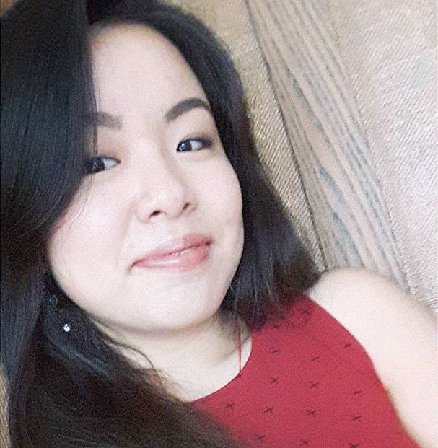
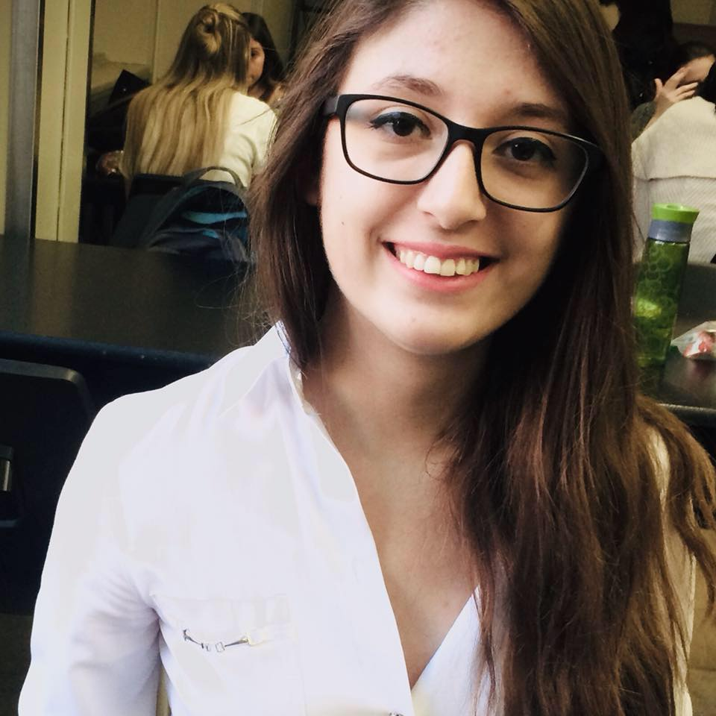
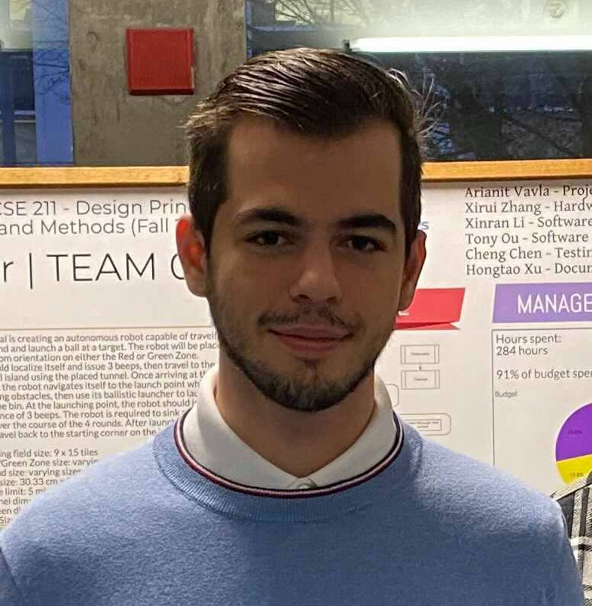
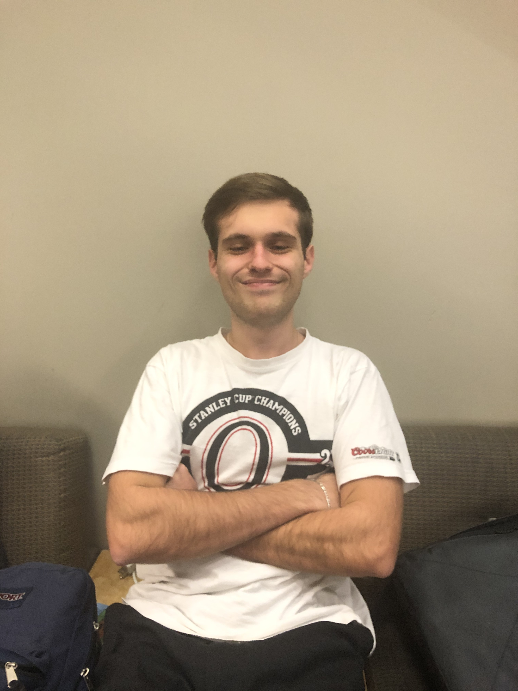

Slide 5












Notes:
1.5
Bootstrap
Node
Springbooth
Special powerpoint techologie
If trouble access Heroku call us
(Good it team)
We gonna see this technologies in actions

Slide 6

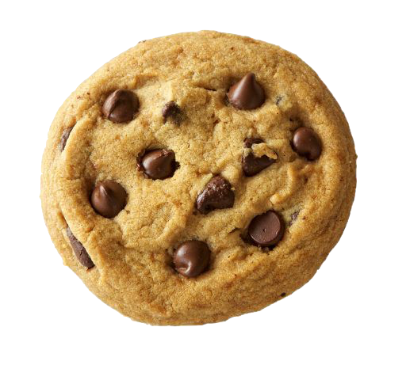



Notes:
1.5

Slide 7


DEMOS!

